Slide 1


Getting more from your data with Power BI
Simon Stride
Exeter IT Lunchtime Sessions

Slide 2

Agenda
What is Power BI? (currently)
How do I get Power BI Desktop?
How do I use Power BI?
Get me some data!
Model me some data
Show me the data!!
That’s nice… What else?
All the charts
Calculated columns
Filters
Custom visualisations
Sharing your dashboards
Excludes
Dataviz best practises
Star Schema best practises
In-Depth data Wrangling

Slide 3
What is Power BI?
Microsoft’s leading tool for data analysis and presentation
Desktop software
Public web sharing
Cloud hosting/sharing options (premium licensing)
Embedding via web parts, SharePoint (premium licensing)
Customisable
Includes processing and compression technologies to wrangle data
Aimed at BI Pros and Analysts, but accessible to users at all levels
Notes:
Although Power BI started out being used primarily as a self-service analytics and BI tool, Microsoft’s reference customers now use it mainly for decentralized analytics (61%) and agile, centralized BI provisioning (54%).
Gartner, 2019

Slide 4
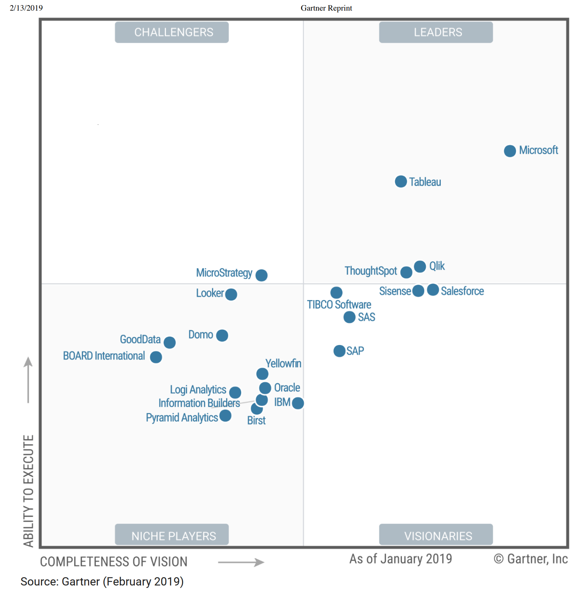
Gartner Magic Quadrant 2019
Microsoft is pushing further into the top right (better)
Microsoft is starting to break away from its nearest competitors
Notes:
Microsoft is a Leader. It has a comprehensive and visionary product roadmap aimed at globalizing and democratizing Power BI for all analytics use cases. At the same time, it continues to demonstrate strong uptake and global adoption of Power BI, with high levels of customer satisfaction
Gartner, 2019

Slide 5

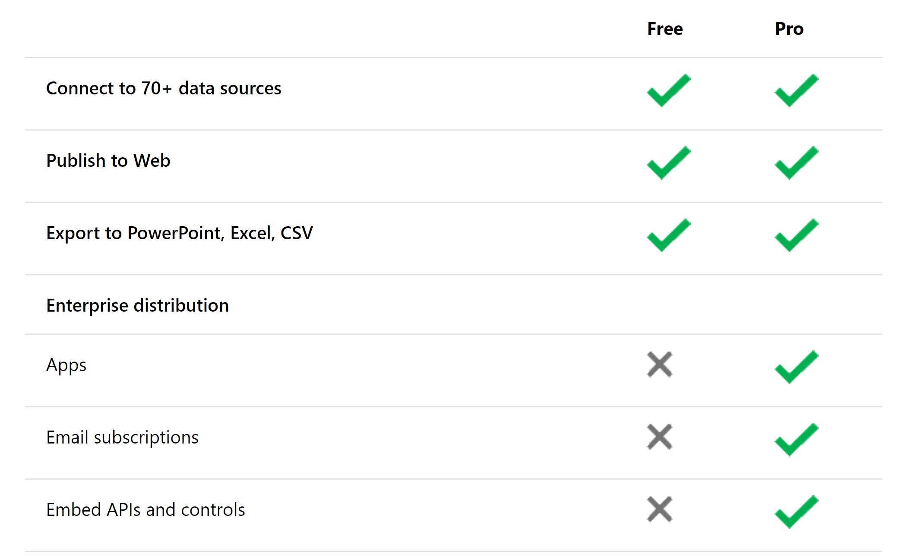
How do I get Power BI?
Download from here:
https://powerbi.microsoft.com/en-us/downloads/
Licensing
Per-user - Power BI Pro licensing and free licensing
Capacity-based - Power BI Premium licensing
https://docs.microsoft.com/en-us/power-bi/service-features-license-type

Slide 6

Getting Started
Demo

Slide 7
Pulling in Data From SQL Server
Demo using “Import”
Notes:
Import – cache the data locally
Direct Query – query the data in situ (avoid unless you know what you’re doing)

Slide 8
Wrangling Data using Power Query
The Secret Super Power…

Slide 9
Resources
Get Power BI
https://powerbi.microsoft.com/en-us/
Chris Webb’s blog
https://blog.crossjoin.co.uk/
Matt Roche’s blog
https://ssbipolar.com/
GuyInACube
https://guyinacube.com/
SQL Bits (free videos)
https://sqlbits.com/content/Event18?type=3
Data in Devon Conference – Saturday is free!
https://sqlsouthwest.co.uk/

